Slide 1
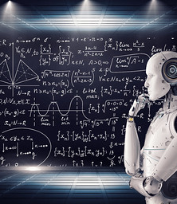
Deep Learning with Python Convolutional Neural Network (CNN)
Edgar Lobaton, Ph.D.
Electrical & Computer Engr. Dept.
North Carolina State University

Slide 2
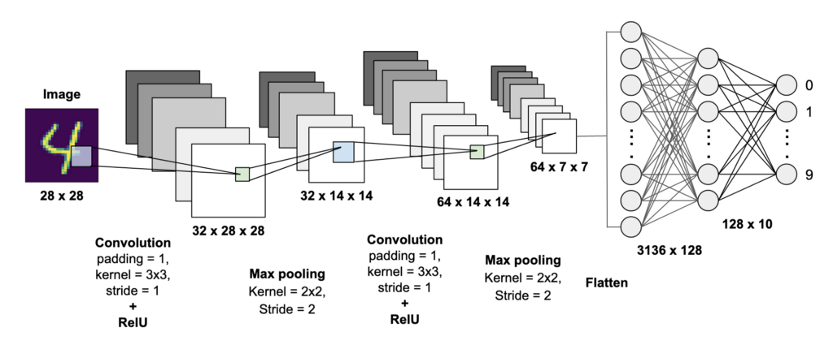
Convolutional Neural Network (CNN)
Main Components: Convolutional Layer (convolution plus activation function), Pooling (subsampling), and Fully Connected Layers
https://mc.ai/building-a-convolutional-neural-network-cnn-model-for-image-classification-2/

Slide 3



Convolution
$$X$$
0 | 1 | 1 | 0 | 0 | 0 | 0 | 1 | 1 | 0
0 | 1 | 1 | 0 | 0 | 0 | 0 | 1 | 1 | 0
0 | 1 | 1 | 1 | 0 | 0 | 1 | 1 | 1 | 0
0 | 0 | 1 | 1 | 0 | 0 | 1 | 1 | 0 | 0
0 | 0 | 1 | 1 | 1 | 1 | 1 | 1 | 0 | 0
0 | 0 | 0 | 1 | 1 | 1 | 1 | 0 | 0 | 0
0 | 0 | 0 | 0 | 1 | 1 | 0 | 0 | 0 | 0
0 | 0 | 0 | 0 | 0 | 0 | 0 | 0 | 0 | 0
Often, we will use a matrix to represent a kernel with a fixed support.
Hyper-Parameters
Kernel Size – The dimensions of the Kernel
Stride – Length of step when sliding the window
Zero Padding – Whether zeros are added around the boundary
Assuming Stride=1, the feature map is always smaller than the input. With Zero-Padding, it is possible to have the same size.
$$K$$
0 | 1 | 0
1 | 2 | 1
0 | 1 | 0
*
$$F$$
- | - | - | - | - | - | - | - | - | -
- | 5 | 5 | 2 | 0 | 0 | 2 | 5 | 5 | -
- | 4 | 6 | 4 | 1 | 1 | 4 | 6 | 4 | -
- | 2 | 5 | 5 | 2 | 2 | 5 | 5 | 2 | -
- | 1 | 4 | 5 | 4 | 5 | 6 | 4 | 1 | -
- | 0 | 2 | 4 | 6 | 6 | 4 | 2 | 0 | -
- | 0 | 0 | 2 | 4 | 4 | 2 | 0 | 0 | -
- | - | - | - | - | - | - | - | - | -
1
=

Slide 4
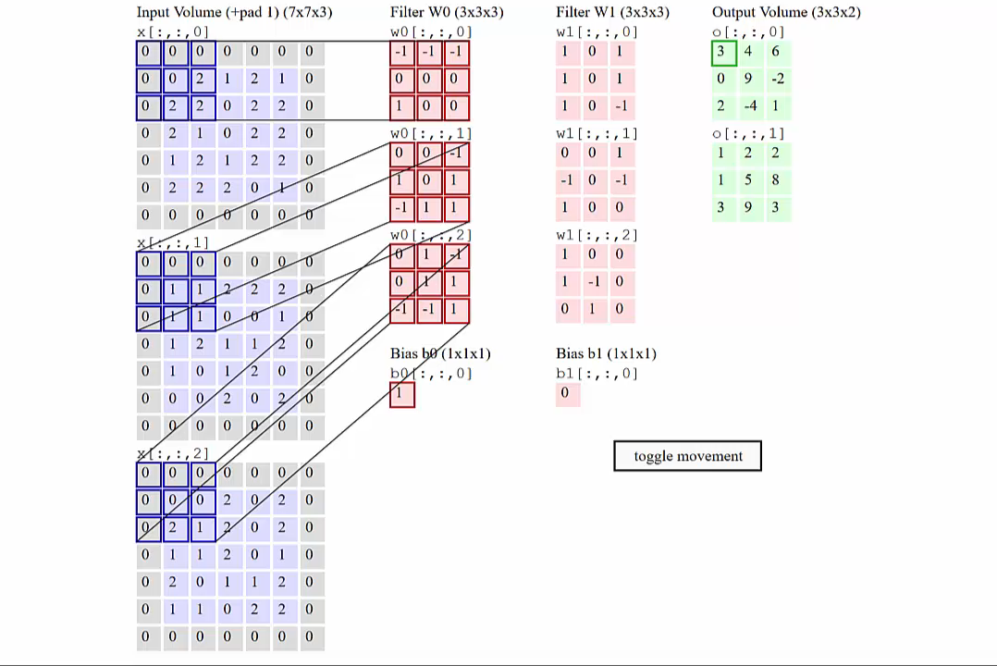
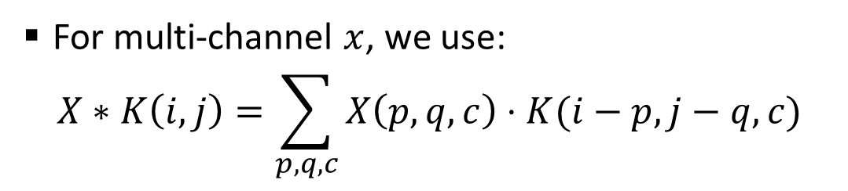
Example.
For multi-channel $x$, we use:
$$X∗K\left(i,j\right)=\sum_{p,q,c}{X\left(p,q,c\right)⋅K(i−p,j−q,c)}$$
http://cs231n.github.io/convolutional-networks/

Slide 5
Convolution Layer
Exploits sparse local interactions and parameter sharing
Equivariance to translation
Multiple feature maps are generated
https://mc.ai/building-a-convolutional-neural-network-cnn-model-for-image-classification-2/

Slide 6
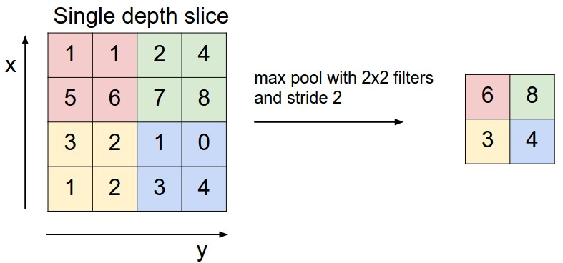
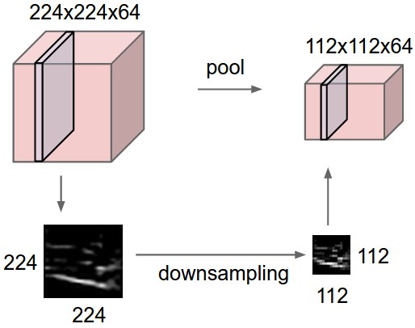
Pooling
It provides a summary statistic of nearby outputs
Max pooling is a common choice. It provides a level of invariance to local translation.
We often just care if a feature (e.g., an eye) is present instead of focusing on the location.
http://cs231n.github.io/convolutional-networks/

Slide 7
Applications
In 1D
Single channel include audio processing, economics, physiological signals
Multi-channel include motion capture, multi-modal physical signals
In 2D
Single channel include grayscale images, spectral analysis of an audio segment
Multi-channel include color image processing, multi-spectral imaging
In 3D
Single channel include medical imaging volumetric
Multi-channel include multi-channel video streams, echocardiograms

Slide 8




Thank you
Edgar Lobaton
edgar.lobaton@ncsu.edu
https://research.ece.ncsu.edu/aros/

